Slide 1
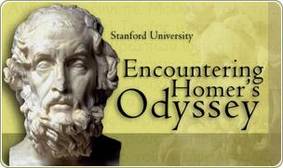
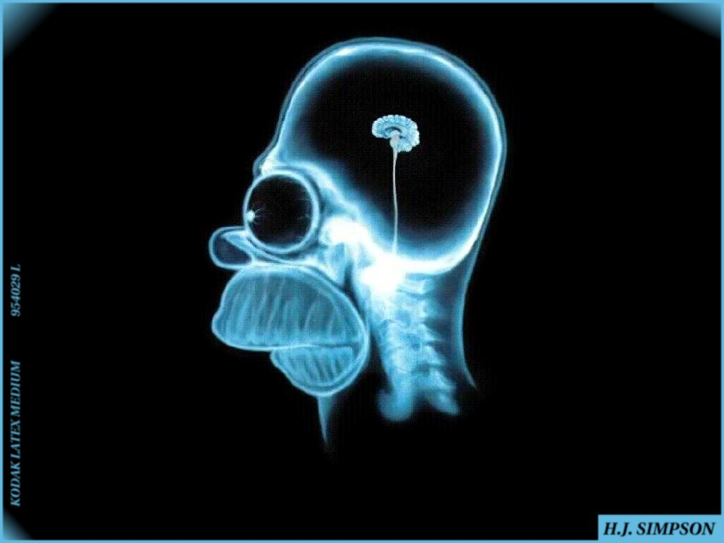
Greek Culture and Art

Slide 2
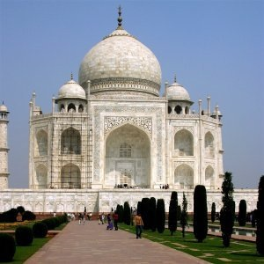
What is a mosaic?

Slide 3
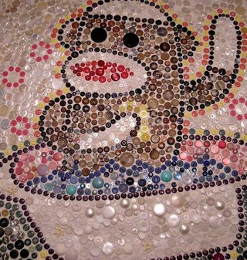

Slide 4
Homer
Epic poem – a long poem that tells the deeds of a great hero
Examples: Iliad and the Odyssey
“That’s me! D’oh!”

Slide 5
Illiad = Story of a war between the Greeks and Troy
The purpose of the war was to recover the most beautiful woman in the world: Helen

Slide 6
The real Homer

Slide 7
VIDEO: Odysseus Returns Home

Slide 8
Video—John Green
Crash Course Odyssey

Slide 10
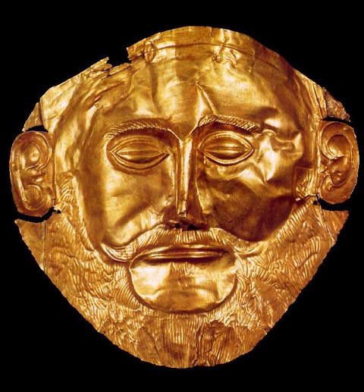

Slide 11
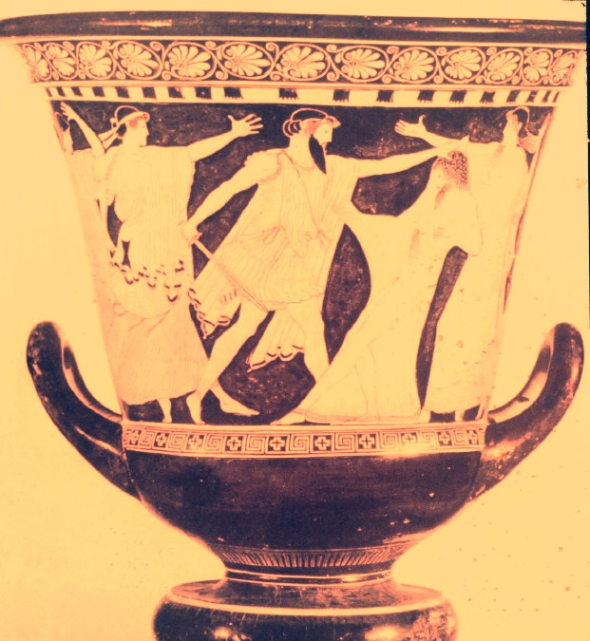
The Death of Agamemnon

Slide 12
The Movie Troy Based on The Illiad Brad Pitt as Achilles

Slide 13
Paris, a Trojan prince, kidnaps Helen, the wife of the king of Sparta.
The Mycenaean Greeks lay siege to Troy for ten years, finally taking the city with the famous Trojan horse.
The Iliad – focuses on the destruction & anger of the Greek hero Achilles.

Slide 14
Paris & Helen

Slide 15
Helen of Troy “The face that launched 1,000 ships”

Slide 16
Homer – Fact or Fiction?
Arete: The Greek word for Excellence
In Homer’s stories and poems they were focused around the hero’s search for Arete/Excellence.

